Slide 1

Cheese Chase
Anirudh Sundar Rajan
Kunal Naik
Prathamesh Dhapodkar
Tae Kim
Rocky Mountain Technologies

Slide 2



What is cheese chase(Tae Kim)
Cheese Chase is an interactive and intuitive store, parking and restaurant locator.
. It gives the users more control over their valuable time with superior experience of digitalization.
It also works towards facility management.
Cheese Chase can redirect users to various social media sites like Yelp for reviews.

Slide 3
features
Cheese Chase provides services which enhance the mall experience for everyday shoppers and store owners.
Real time store location helps customers reach their desired store

Slide 4
Features
Cheese Chase also lists out restaurants present on site.
Shows availability of on-site parking or at a nearby location

Slide 5
The Problem
Everyday, millions of people around the world visit malls and restaurants, frustrated by the unavailability of parking, and the struggle of finding specific stores and restaurants
Oftentimes, due to unavailability of parking, people cancel their plans leading to frustration of the customers and loss of business for the mall and storeowners

Slide 6
This is where Cheese Chase comes into the picture
The mapping technology provides accurate locations for all the stores, kiosks and restaurants
The restaurant page also contains links to various review websites where people can stay informed on availability of tables as well as the reviews by other customers

Slide 7
This project is being developed using Agile Methodology
Agile enables us to dynamically develop the project and incorporate changes or new features at any point during development.

Slide 8
Cheese Chase provides three primary functionalities
Show Down: Service which navigates you to the desired store turn by turn from the available stores in the mall.
Chow Down: Service which navigates you to the desired eatery turn by turn from the available restaurants in the mall.
Nestle Down: Service which navigates you to the nearest available parking spot from your current location in the mall.

Slide 9
Tools and services required
Cheese Chase will be developed in an agile methodology which includes reporting to the managers according to the new POD structures. Managing the project dashboards, timelines and Roadblocks with JIRA and Confluence Software. Conduct daily scrum meetings, run project estimate tool and update them on all the platforms for every sprint.
Software contracts with JIRA and Confluence, AWS Cloud, Android and IOS, Jibestream’s mapping and location technology and Inpixon's Indoor IPA technology, IPA sensors, video surveillance solutions, Wireless connectivity assurances, Google GPS offerings, Mendix App creating solutions, IBM Systems, Skype for Business and PeopleSoft.

Slide 10
Time Management (Tae Kim / Anirudh)
Plan Schedule Management
Define Activities
Sequence Activities
Estimate Activity Resources
Estimate Activity Durations
Develop Schedule
Control Schedule

Slide 11

Plan Schedule Management
WBS is an efficient method to divide responsibilities among the team.
Apart from following strict schedules, risk identification, mitigation and proper communication routes between the stakeholders and the team are also vital.

Slide 12
Defining Activities
We are using Project Libre to schedule and define activities. Project Libre is an open source project management tool. Using project Libre, we can schedule activities, load balancing, and budgeting and generate various figures to help us monitor and make changes to the milestones easily

Slide 13

Sequence Activities
We have used network diagrams to determine the sequence of activities. Critical path is a useful tool to deduce the activities which are independent of other activities and create the shortest path to project completion. Critical Path displays parameters for each activity like the Early Start, Early Finish, Late Start and Late Finish. It also helps represent the relationships between two activities such as –
Start to Start
Start to Finish
Finish to Start
Finish to Finish

Slide 14
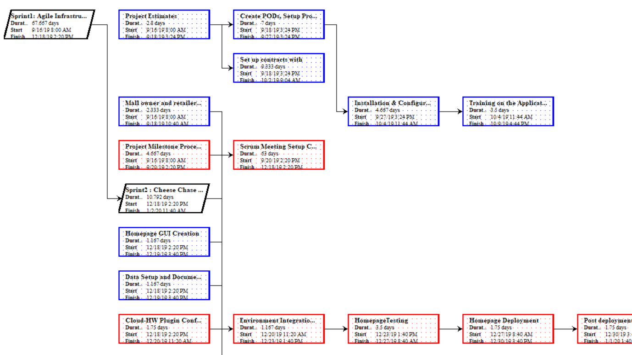

Slide 15
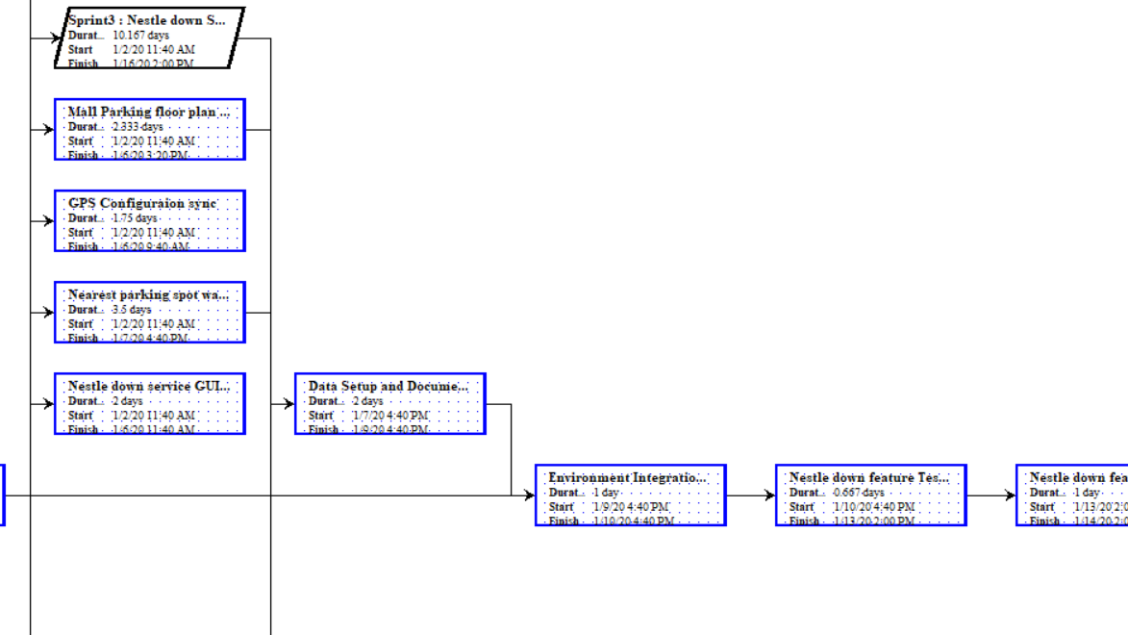

Slide 17
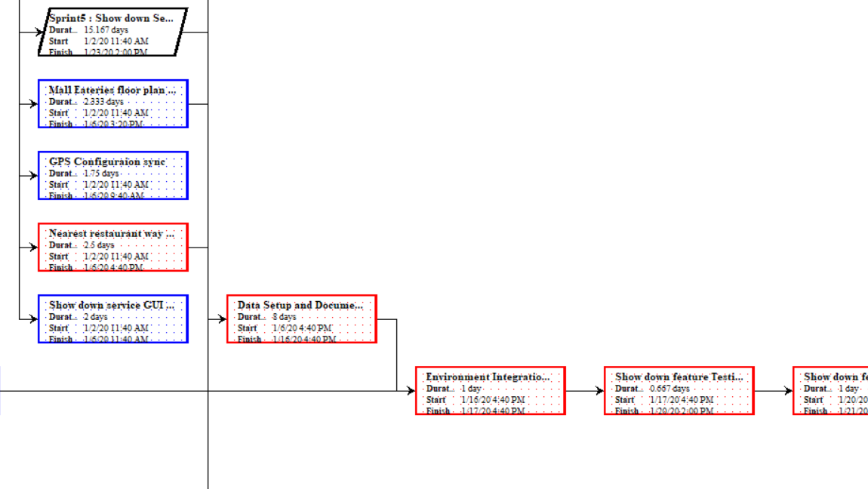

Slide 18
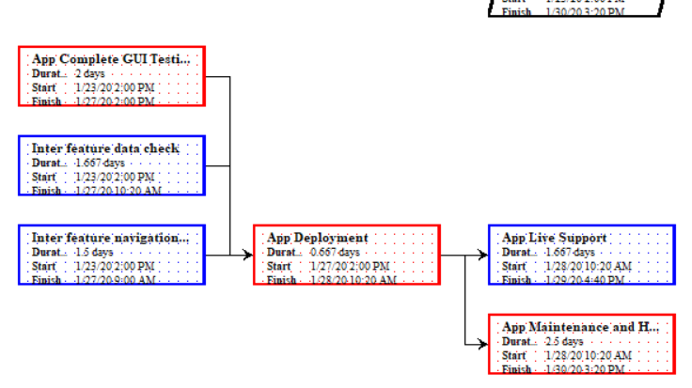

Slide 19
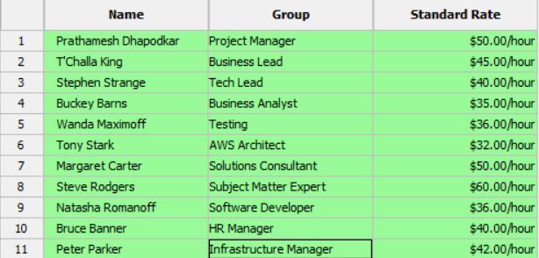
Estimate Activity Resources
A Resource chart assists with budgeting, wage splits and resource management of the project.

Slide 20
Estimate Activity Duration
The length and OpEx(Operational Expenditure) of the project is estimated by using detailed analysis of Schedule and Budget

Slide 21
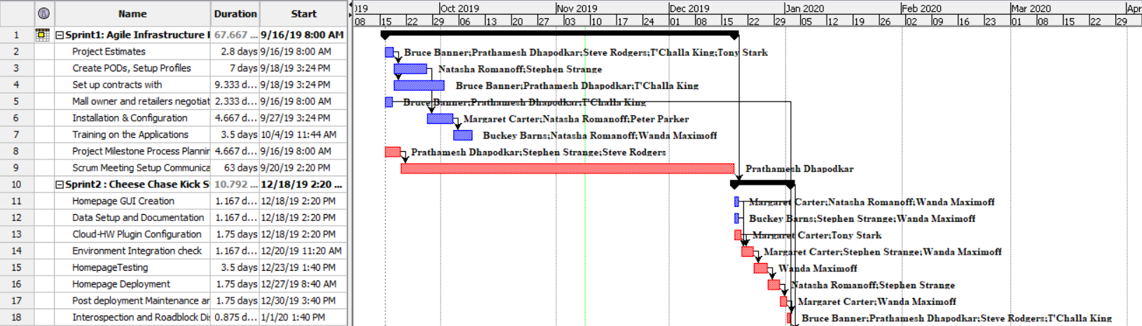
Develop a Schedule

Slide 22
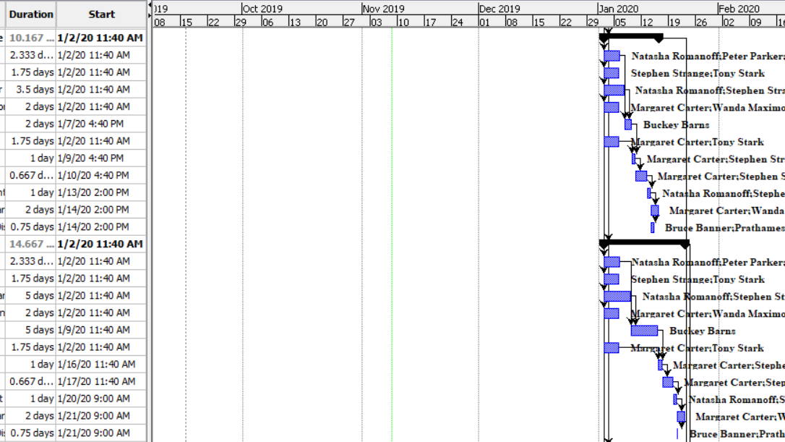

Slide 23
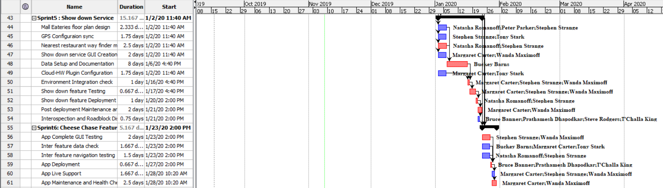

Slide 24
Control Schedule
In Cheese Chase, the project manager has complete discretion to control the schedule and ensure timely delivery of activities.

Slide 25

Cost Management (Anirudh)
Cost management helps us determine the estimated budget, funding and financial constraints of the project.
This is crucial in order to ensure that all the tasks are completed within allocated budget

Slide 26





Estimated Budget
Our estimated budget is generated towards procurement of the following hardware and services –
Hardware Maintenance
Wages
Software
Agile Tools
Cloud Services
Navigation Services
Infrastructure
Consultants
Miscellaneous

Slide 27
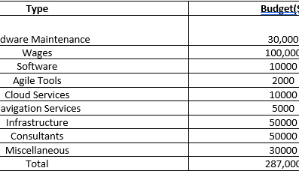
. Monitoring/Controlling Budget

Slide 28
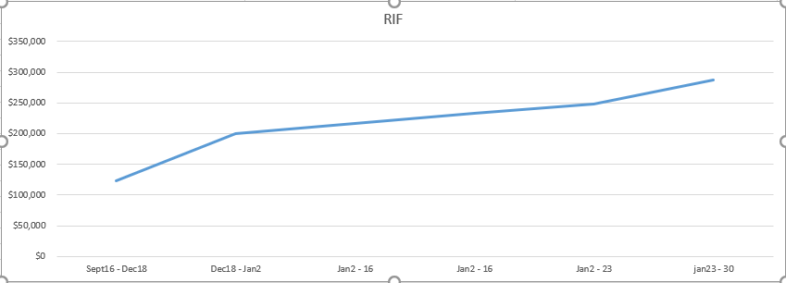
???

Slide 29
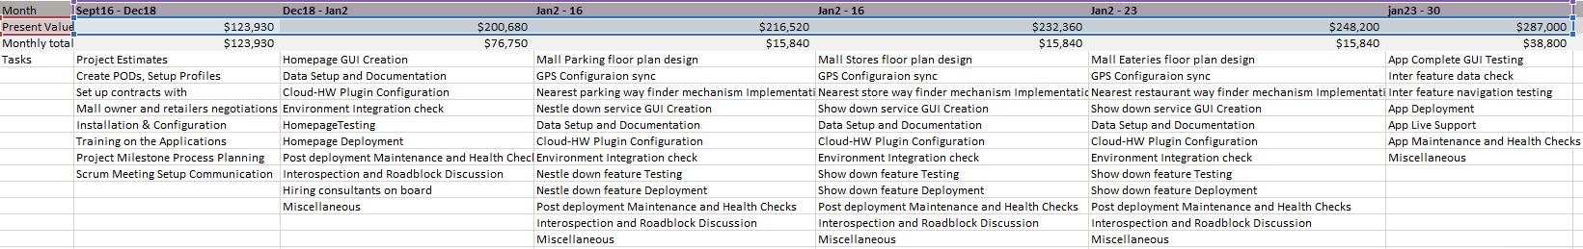
Time Phased Budget

Slide 30
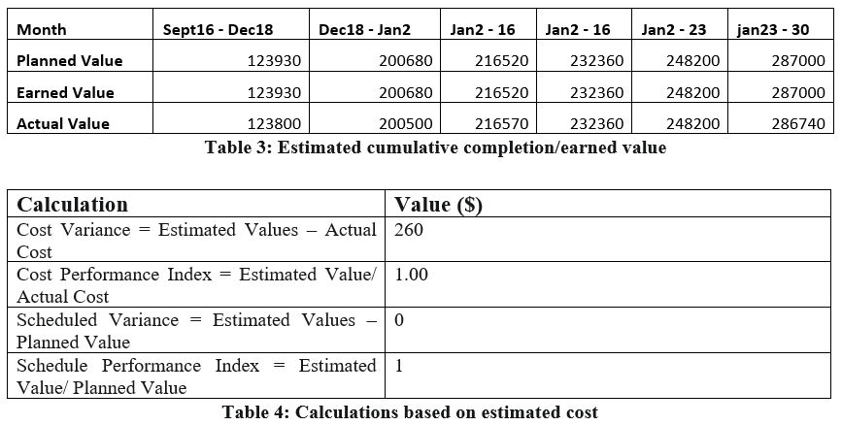

Slide 31

Quality Management (Kunal)
Quality Management is essential in order to make sure that the project is up to par with internationally accepted standards, objectives and responsibilities assigned at the start of the project.
Quality Assurance is a major part of managing the quality of a project.

Slide 32
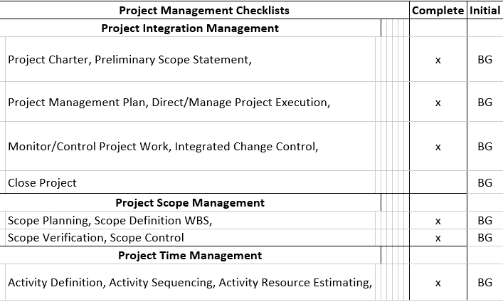
Quality Checklist

Slide 33
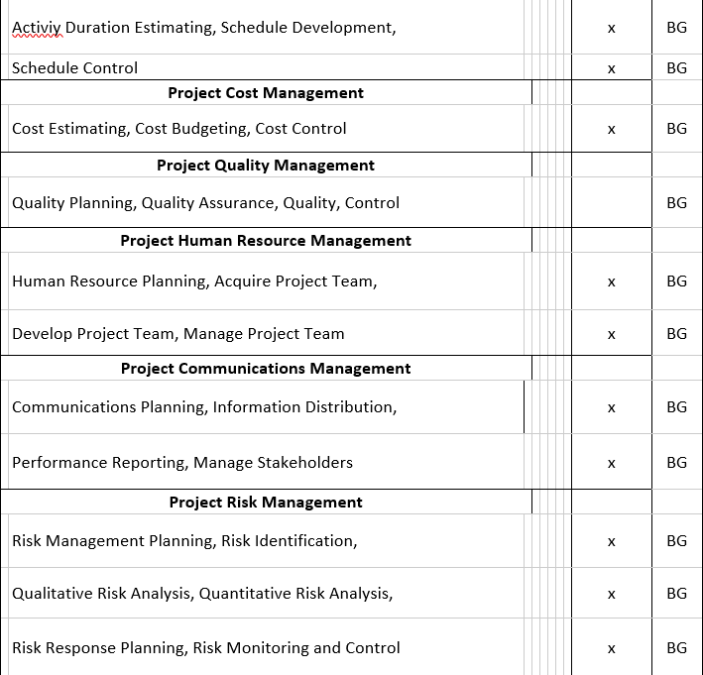

Slide 34
Monitor and Control
Quality Control and Assurance is done so that customer satisfaction is guaranteed. The aim of the project is to provide services of high standards without any hassle to the customers.
This also helps in ensuring that customer feedback is productively used to make improvements. So, the project manager’s role is vital to project execution.

Slide 35

(KUNAL)

Slide 36
With the help of risk management, we can analyze, identify and mitigate potential risks in order to avoid glitches and bugs.
It is highly recommended to continuously monitor for potential risks at every stage

Slide 37
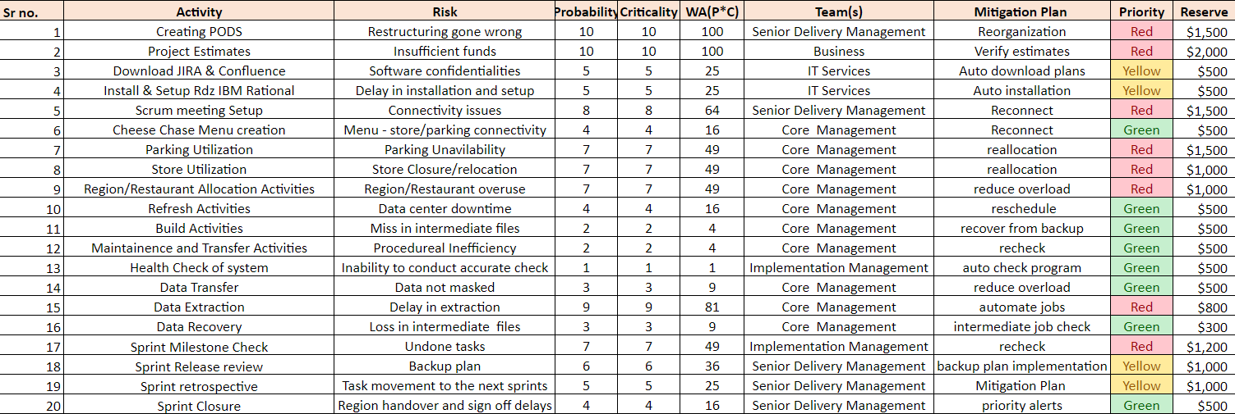

Slide 38

Human Resource Management (Prathamesh)
In order to successfully complete this project, we need a considerable large team of experts.
To manage the workflow of the team we need human resource management which ensures the smooth working of the team

Slide 39
Team Members and Responsibilities
Role in Project | Expectation of Project
Project Manager | Manages Scrum meetings and checks on project status.
Business lead | Observes the progress of the project based on business needs.
Tech Lead | Manages the development of the project.
Business Analyst | Bridges the gap between developers and business.
Testing Manager | Leads the testing department for implementation.
AWS Architect | Develops and manages the cloud for the project.
Solutions consultant | Monitors the smooth functionality of the project based on business standards of the company.
Subject Matter Expert | Manages advising and training departments.
Senior Software Developer | Manages the development of the project.
HR Manager | Manages the workforce and checks the smooth functioning among stakeholders.
Infrastructure Manager | Manages the administration and onsite requirements based on structural requirements.

Slide 40
Responsibility Matrix
Designation | Sprint1 | Sprint2 | Sprint3 | Sprint4 | Sprint5 | Sprint6
Project Manager | ✔ | ✔ | ✔ | ✔ | ✔ | ✔
Business Lead | ✔ | ✔ |  |  |  | ✔
Tech Lead | ✔ | ✔ | ✔ | ✔ | ✔ | ✔
Business Analyst | ✔ | ✔ | ✔ | ✔ | ✔
Testing Manager |  | ✔ | ✔ | ✔ | ✔ | ✔
AWS Architect | ✔ | ✔ | ✔ | ✔ | ✔ | ✔
Solution Consultant |  | ✔ | ✔ | ✔ | ✔ | ✔
Subject Matter Expert | ✔ | ✔ | ✔ | ✔ | ✔ | ✔
Senior Software Developer |  |  | ✔ | ✔ | ✔
HR Manager | ✔ | ✔ | ✔ | ✔ | ✔ | ✔
Infrastructure Manager | ✔ | ✔ | ✔

Slide 41
Communication Management (Prathamesh)
Communication is essential since it is responsible for keeping all the key stakeholders informed.
It helps in understanding the progress of the project and helps establish a rapport between the team and senior management.
The various forms of communication include daily scrum meetings, emails, status reports, text messages.

Slide 42
Communication Plan
Project Phase | Information Provider (the sources) | Frequency | Method of Communication (the media)
Project Initiation | Business, Scrum master | Once a week | Meeting, Formal update
Project Planning meeting | Scrum master | Once a week | Meeting, Formal update
Project Kickoff/Prep | Scrum master | Once a week | JIRA, Confluence
Daily Scrum | Scrum master | Daily | Standup meeting, JIRA, Confluence
Sprint Milestone Check | Business, Scrum master | Bi-weekly | JIRA, Confluence
Sprint Release review | Business, Scrum master | Once a week | Meeting, Formal update, JIRA, Confluence
Sprint retrospective | Scrum master | Once a week | Formal update
Sprint Closure | Business, Scrum master | Once a week | Meeting, Formal update, JIRA, Confluence

Slide 43

The End
Thank You
Anirudh Sundar Rajan
Kunal Naik
Prathamesh Dhapodkar
Tae Kim

